Slide 1

Customer Churn Diagnostic
Uncovering what separates churning from loyal customers, and where Airtel should intervene (4,250 customers)

Slide 2

Executive Diagnostics
An analysis of 4,250 labelled customer accounts to find what separates churners from stayers and where retention effort pays off.

Slide 3

The Customer Churn Landscape
14.1%
One in Seven Customers Churned
Out of 4,250 labelled customers, 598 churned (14.1%). Their billing was about 39K per period, roughly 470K a year if billing is monthly (assumption).
The churn rate is not spread evenly: customers with 4+ service calls, high day usage or an international plan churn at 42% to 51%, against about 11% for the rest.
Overall Customer Churn Rate

Slide 4
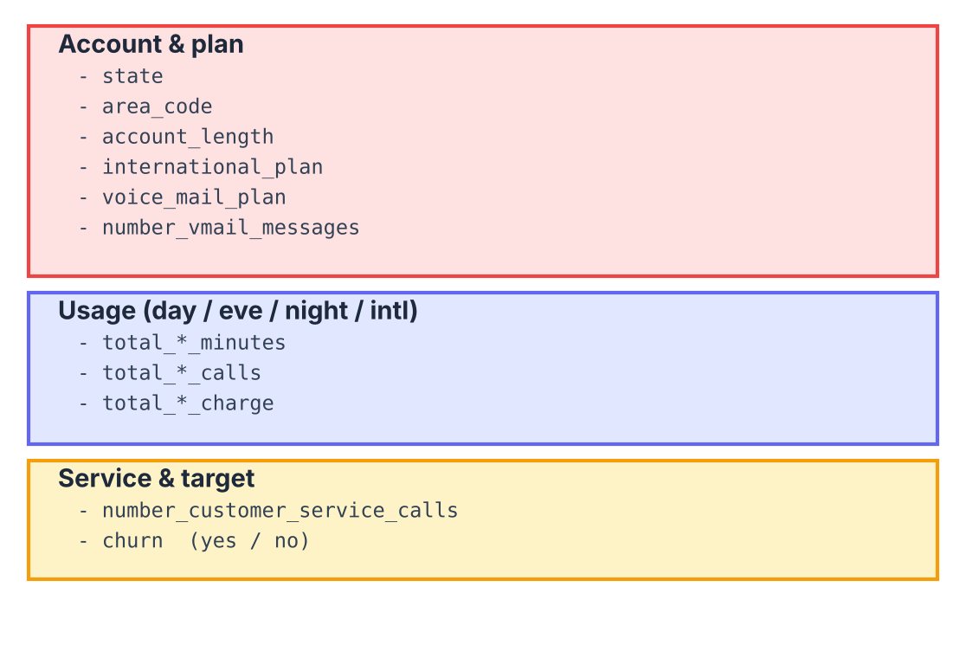
Dataset & Analytics Scope
4,250 Customer Profiles: labelled records from train.csv (test.csv has no churn labels and is not used).
Account & Plan Variables: state, area code, account length, international and voice mail plans, voice mail messages.
Usage & Service Variables: day, evening, night and international minutes, calls and charges, plus customer service calls.

Slide 5


Primary Attrition Catalysts
1. Customer Service Calls
2. International Plan
Churn sits near 11% for 0 to 3 service calls, then jumps to 44.0% at 4 calls, 60.5% at 5 and 64.4% at 6 or more. The 335 customers with 4+ calls churn at 50.7%, 4.6x the rest.
Plan holders churn at 42.2% against 11.2% without the plan (3.8x). Within the plan, above-median international charges churn at 50.8% vs 33.7%.

Slide 6






Core Behavioral Churn Drivers
Heavy Day Usage
Voice Mail Plan
Area & Tenure Do Not Matter
Customers using over 250 day minutes churn at 48.9% vs 10.2% (4.8x); above 300 minutes it reaches 81.0%.
Customers with a voice mail plan churn at 7.4% vs 16.4% without one, and the plan lowers churn even among international-plan holders.
Area codes sit within 13.6% to 15.1%, and account length has a correlation of 0.02 with churn: neither is a useful target.

Slide 7
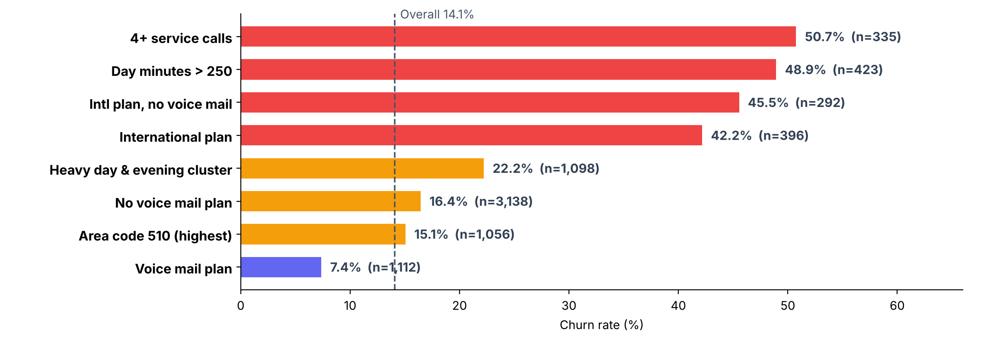
Churn Comparison Across Segments
Four segments churn at 42% to 51%, 3 to 5 times other customers; area code shows no such gap.

Slide 8
High-Risk Customer Segment Matrix
Customer Segment Profile | Churn Rate | Customers | Primary Risk Driver | Risk Level
4+ Customer Service Calls | 50.7% | 335 | Unresolved issues reaching a 4th call | Critical
Day Minutes Above 250 | 48.9% | 423 | Heavy daytime users on current plans | Critical
International Plan, No Voice Mail | 45.5% | 292 | Plan value gap, no bundled features | Critical
International Plan | 42.2% | 396 | Pricing or fit of international plan | Critical
Heavy Day & Evening Cluster | 22.2% | 1,098 | High daytime and evening usage | High

Slide 9

Support & Service Friction
Service Calls as a Warning Signal
Churn stays near 11% up to three service calls, then jumps to 44.0% at four, 60.5% at five and 64.4% from six calls (n=209, 81, 45).
The fourth call is the trigger point: route these customers to a retention-trained agent and fix the root cause proactively.

Slide 10




Retention Strategy Roadmap
Q2 - Heavy Users
Q4 - Risk Scoring
Offer higher-allowance day plans to customers approaching 250 day minutes.
Score customers with the logistic model (AUC 0.83) and review those at 30%+ risk.
Q1 - Service Calls
Q3 - Intl Plan
Flag customers at their 3rd service call; trigger proactive resolution and a save offer.
Re-price or bundle the international plan with voice mail; it carries 3.8x churn.

Slide 11
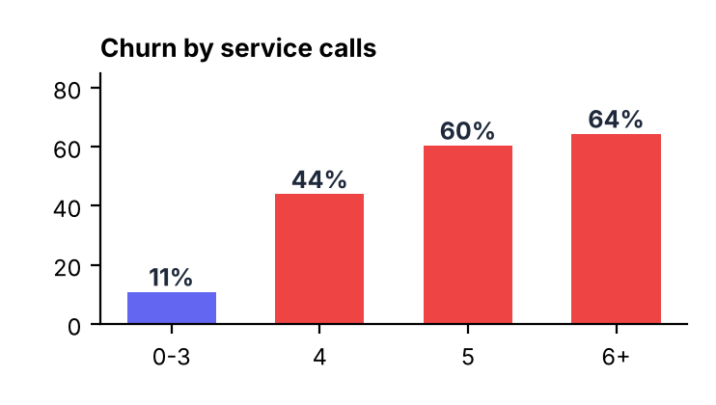
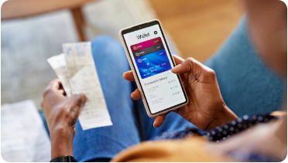

Strategic Retention Pillars
Service Recovery
Plan Fit
Churn Risk Scoring
Escalate at the third service call and fix root causes before the fourth.
Right-size day-minute plans and bundle voice mail with international offers.
Rank customers with a logistic-regression score; no machine learning is required.

